Slide 1




Bug Tracking Systems
Performing Tests and Reporting Issues
QA
Fundamentals
Ivan Yonkov
Technical Trainer
http://github.com/RoYaLBG
Software University
http://softuni.bg

Slide 2

Table of Contents
Performing a Test
Bug Tracking Systems
JIRA
GitHub Issues
Reporting Issues

Slide 3
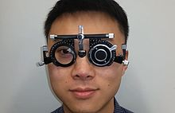
Performing a Test

Slide 4

Performing a Test
Usually a certain feature or a bugfix is tested
One draws testing steps
Should find
The intentional behavior
The unexpected behavior

Slide 5
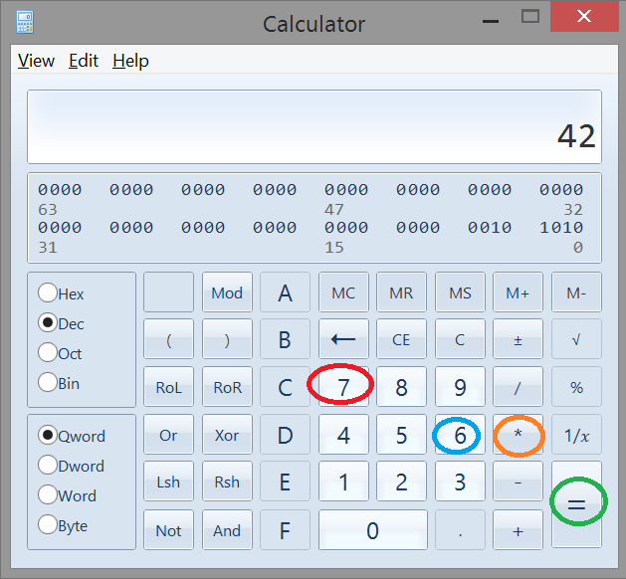
Performing a Test (2)

Slide 6


Slide 7

Bug Tracking Systems

Slide 8
Bug Tracking Systems
What is a bug tracking system?
A bug tracking system or defect tracking system is a software application that keeps track of reported software bugs in software development projects. It may be regarded as a type of issue tracking system.

Slide 9
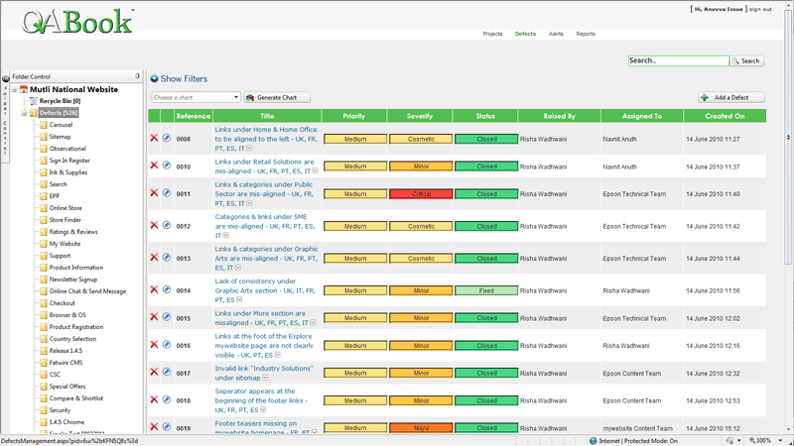
Bug Tracking Systems (2)

Slide 10
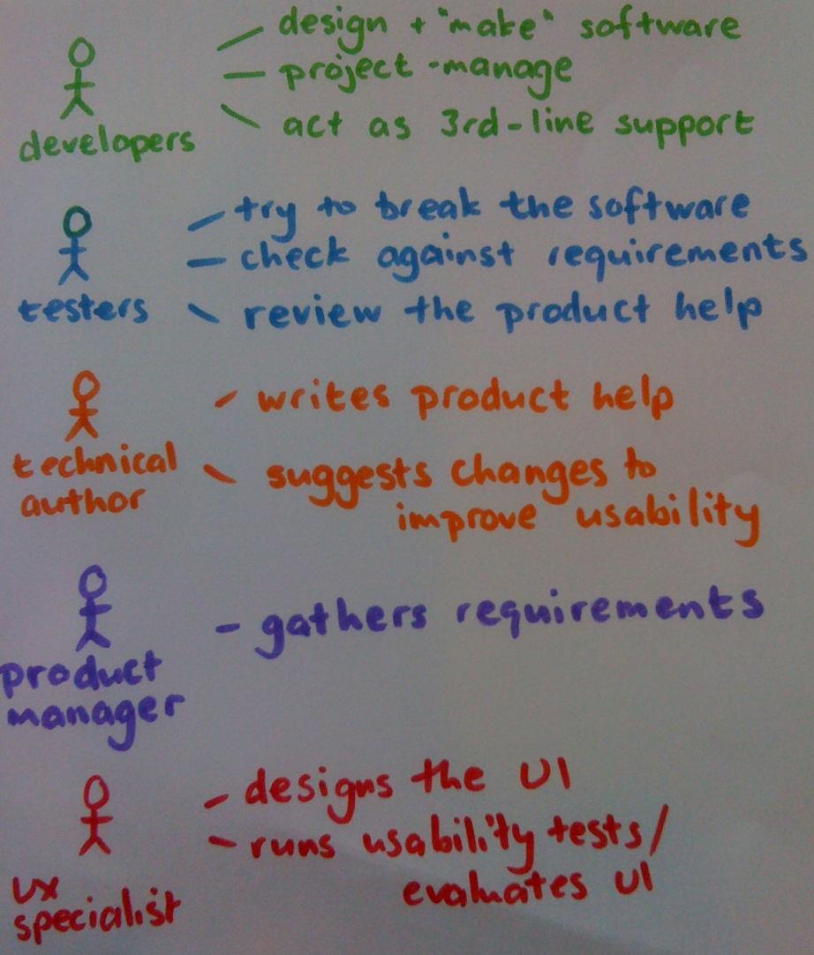
Bug Tracking Systems (3)
Part of the whole project management
Allows
Work tracking
End-user reporting
Easier communication
Consistent use of an issue tracker is considered one of the hallmarks of a good software team

Slide 11
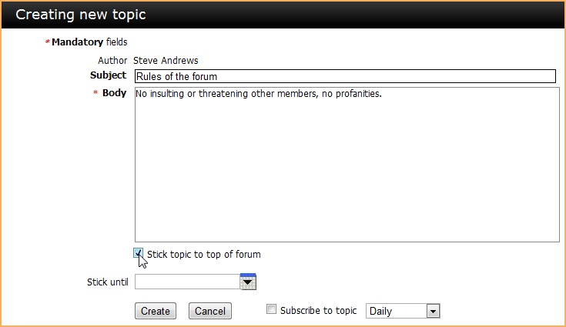
Bug Tracking Systems (4)
Bugs are reported in a forum-like topics
Prioritized
Reach the
Developer according to the process
QA after being fixed

Slide 12
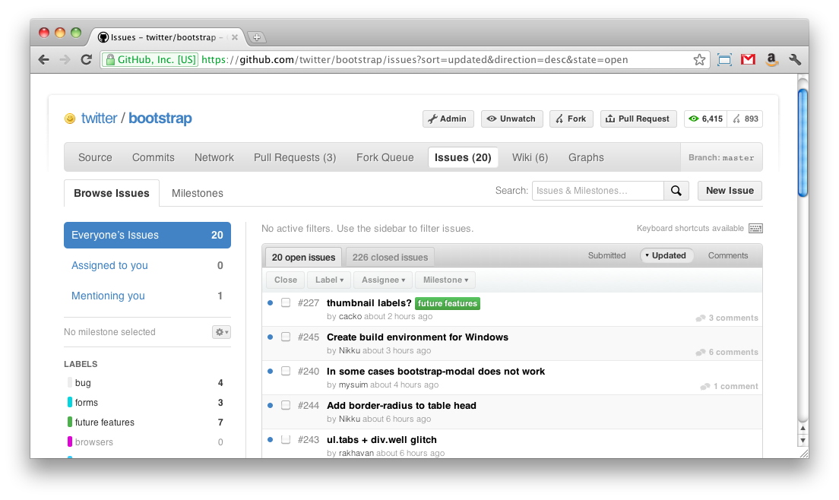
GitHub Issues – Live Demo

Slide 13
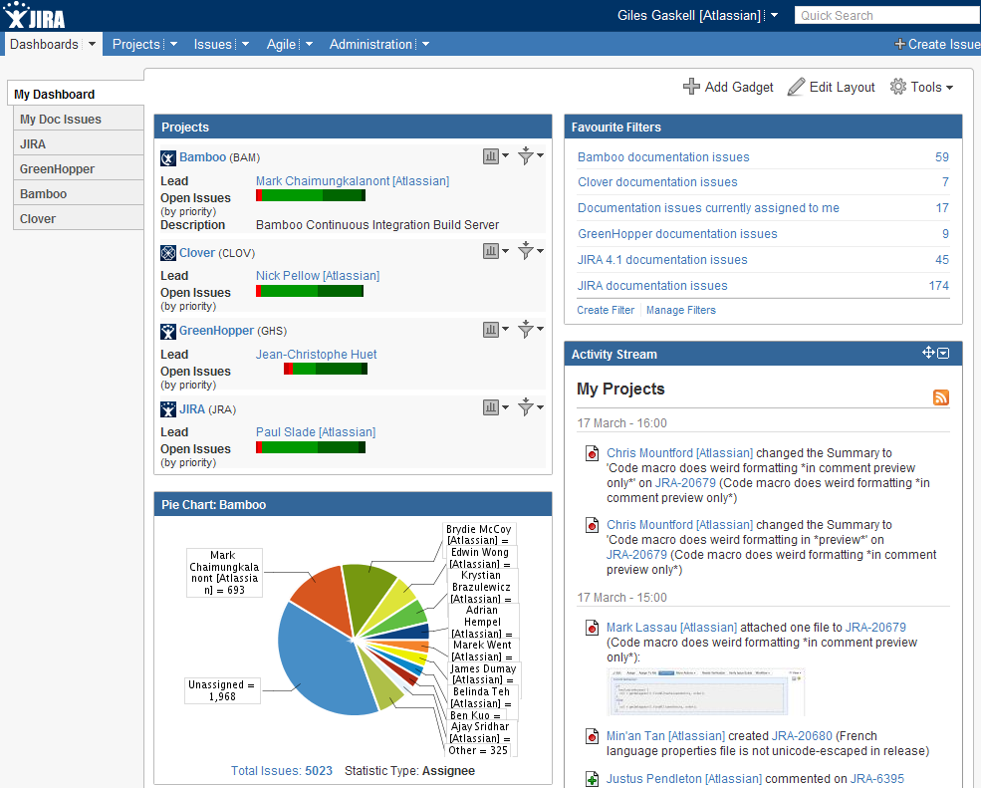
JIRA – Live Demo

Slide 14

Summary
Performing a Test
What is an issue tracker?
JIRA
GitHub Issues
How to report an issue?
How to manage the workflow?

Slide 15









http://softuni.org/courses

Slide 16
License
This course (slides, examples, demos, videos, homework, etc.) is licensed under the "Creative Commons Attribution-NonCommercial-ShareAlike 4.0 International" license
Attribution: this work may contain portions from
"Fundamentals of Computer Programming with C#" book by Svetlin Nakov & Co. under CC-BY-SA license
"C# Part I" course by Telerik Academy under CC-BY-NC-SA license

Slide 17





Free Trainings @ Software University
Software University Foundation – softuni.org
Software University – High-Quality Education, Profession and Job for Software Developers
softuni.bg
Software University @ Facebook
facebook.com/SoftwareUniversity
Software University @ YouTube
youtube.com/SoftwareUniversity
Software University Forums – forum.softuni.bg

